Slide 1
Ergonomic Exercises At Your Desk

Slide 2
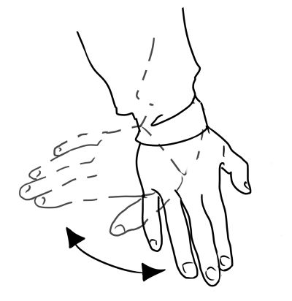

Wrist Tilt Exercise

Slide 3
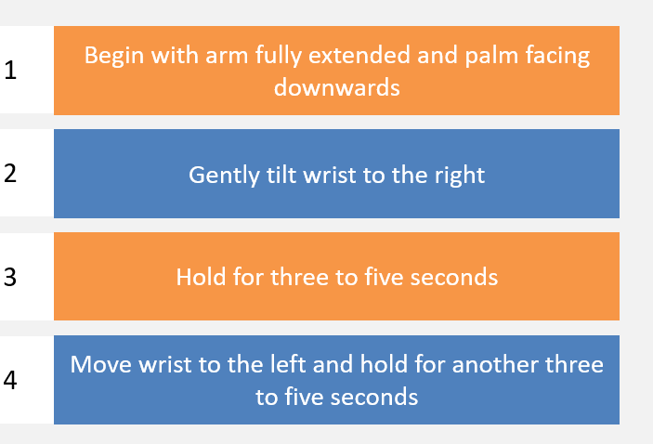
Wrist Tilt

Slide 4
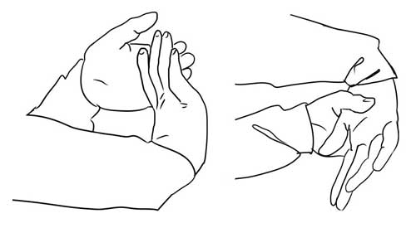
Wrist Flexion Exercise

Slide 5
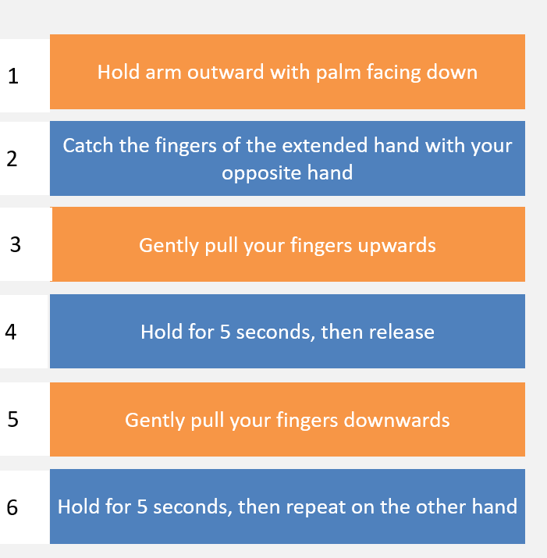
Wrist Flexion Exercise/Stretch

Slide 6
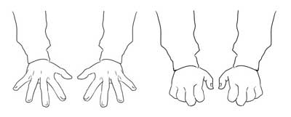
Extended Finger Stretch

Slide 7
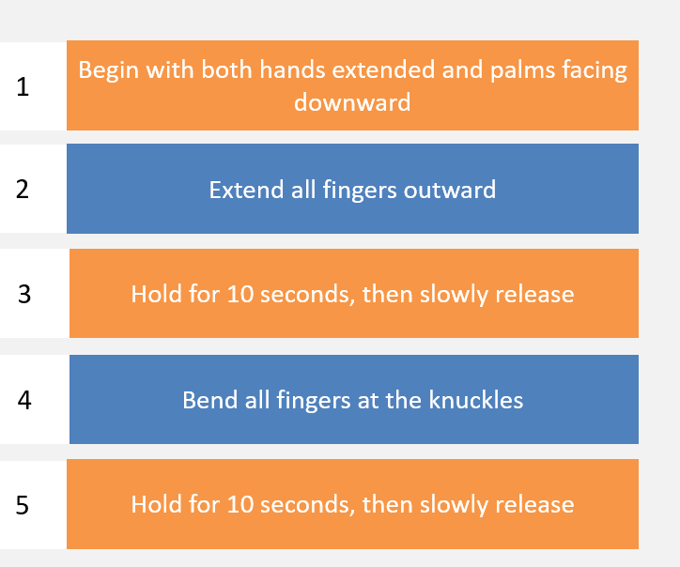
Extended Finger Stretch

Slide 8
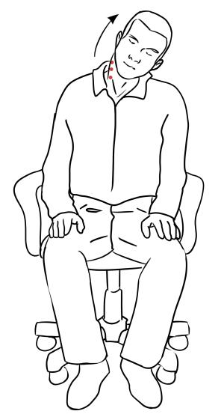
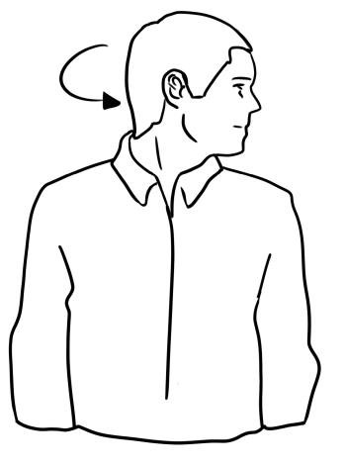
Neck/Upper Back Stretches

Slide 9
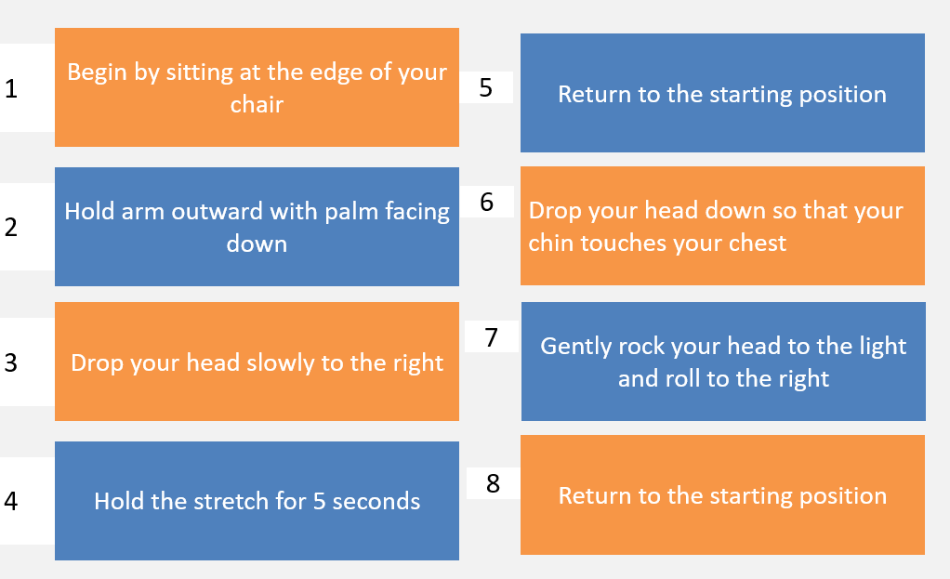
Neck Stretch

Slide 10
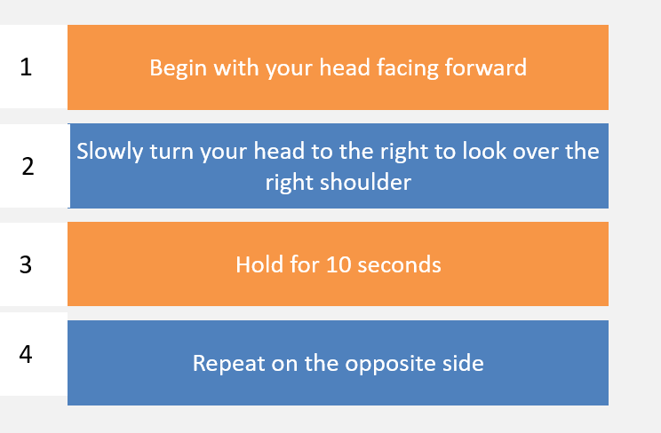
Neck Rotation/Head Turns

Slide 11
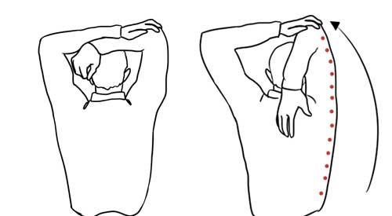
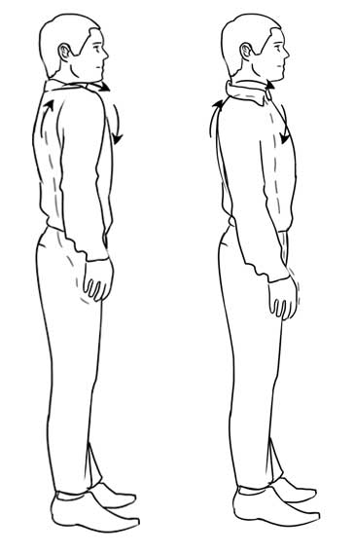
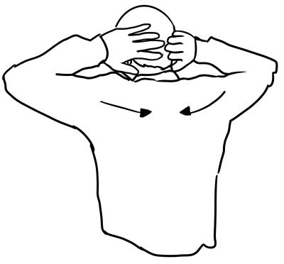
Shoulder/Chest Stretches
Overhead Shoulder Stretch
Shoulder Rolls
Chest Stretch/Shoulder Blade
Squeeze

Slide 12
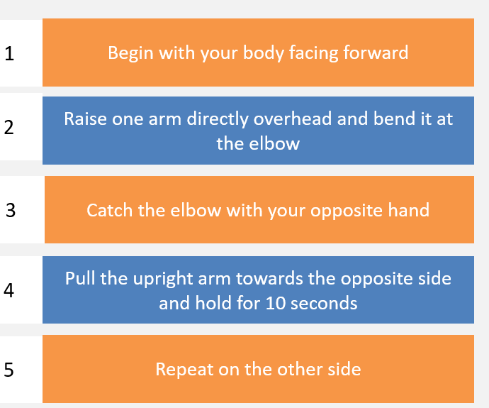
Overhead Shoulder Stretch

Slide 13
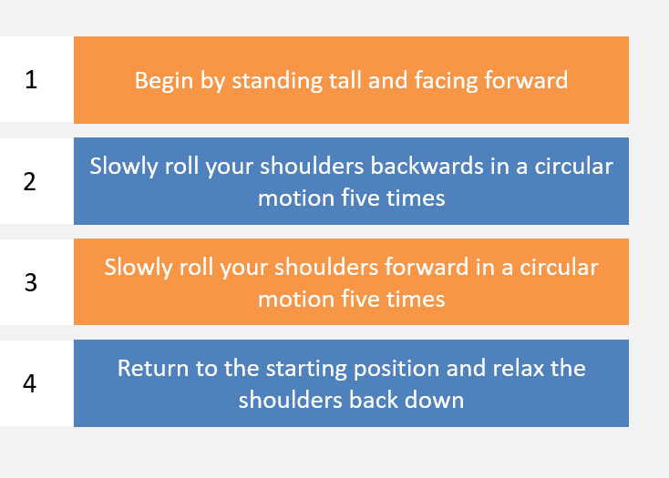
Shoulder Roll

Slide 14
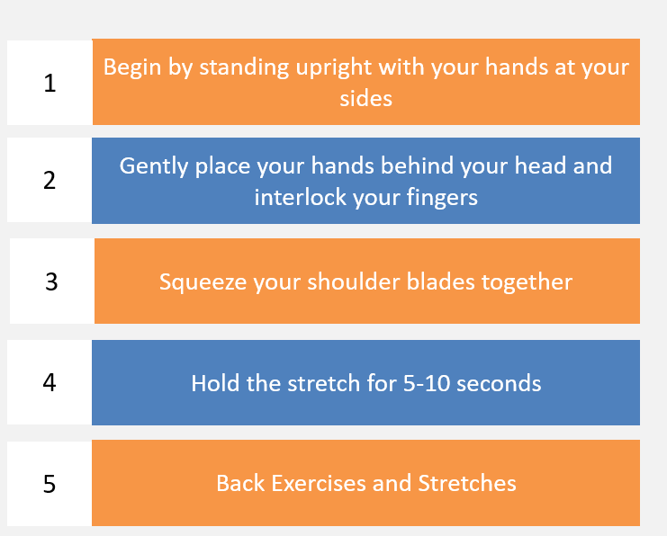
Chest Stretch/Shoulder Blade Squeeze

Slide 15
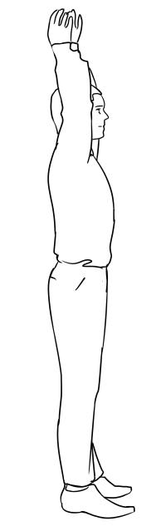
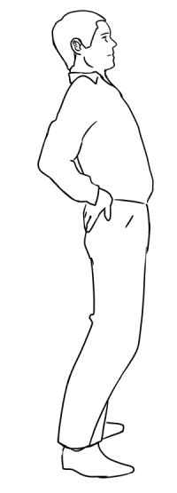
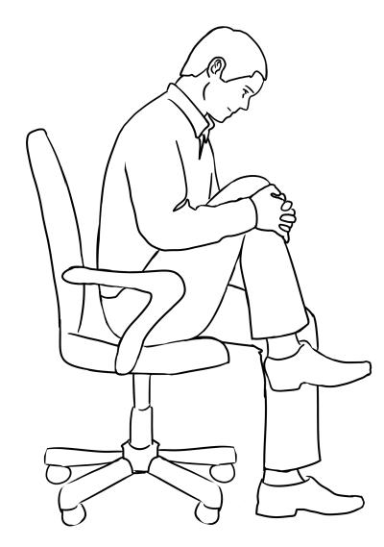
Low Back Stretches
Standing Low Back Stretch
Seated Low Back Curl/Stretch

Slide 16
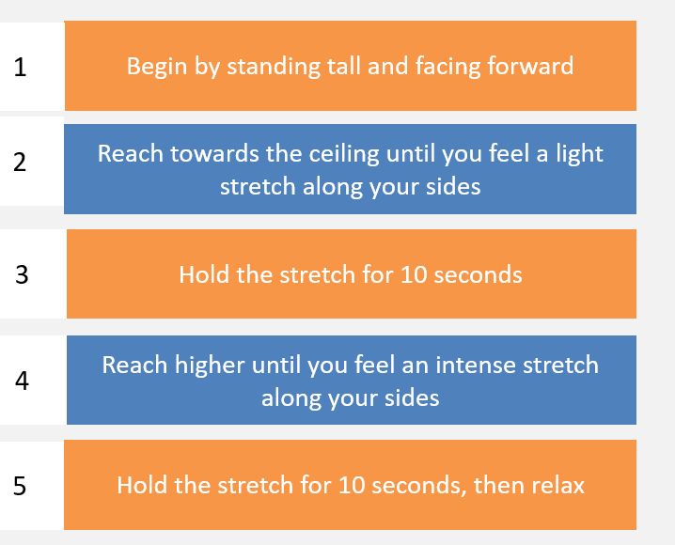
Standing Low Back Stretch

Slide 17
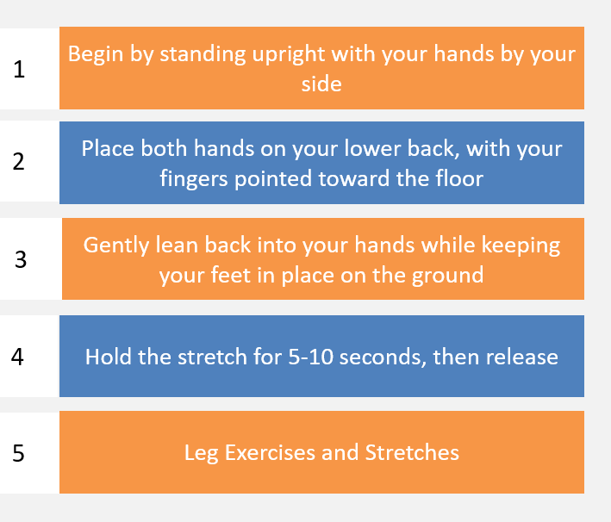
Standing Low Back Stretch

Slide 18
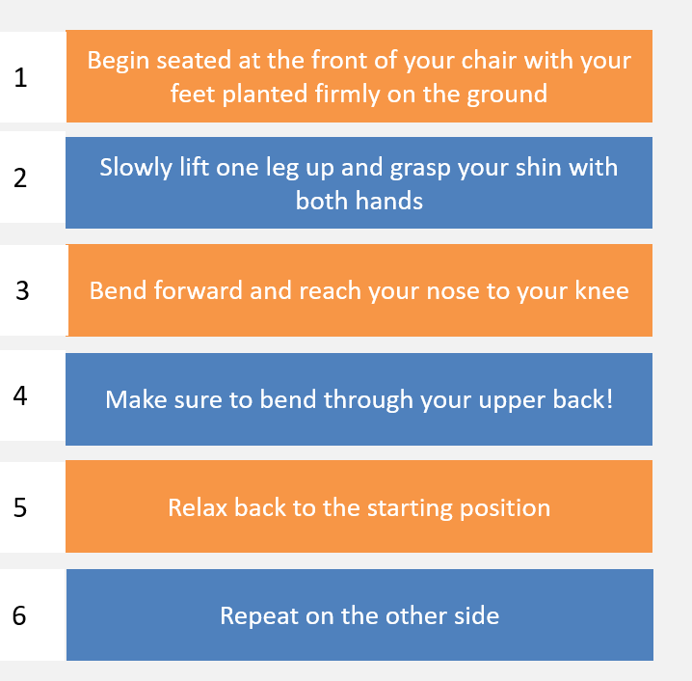
Seated Low Back Curl/Stretch

Slide 19
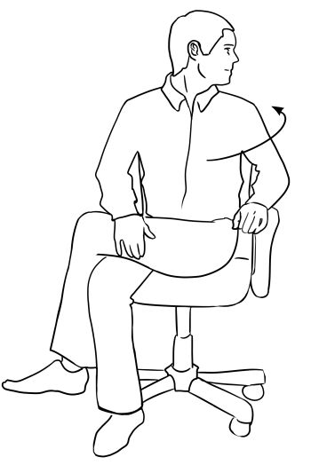
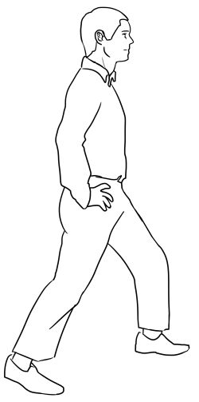
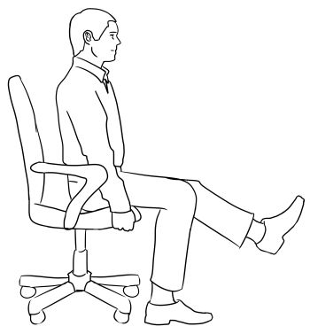
Lower Extremity Exercise/Stretches
Calf Stretch
Seated Left Lift /
Hamstring Stretch
Seated Hip Stretch

Slide 20
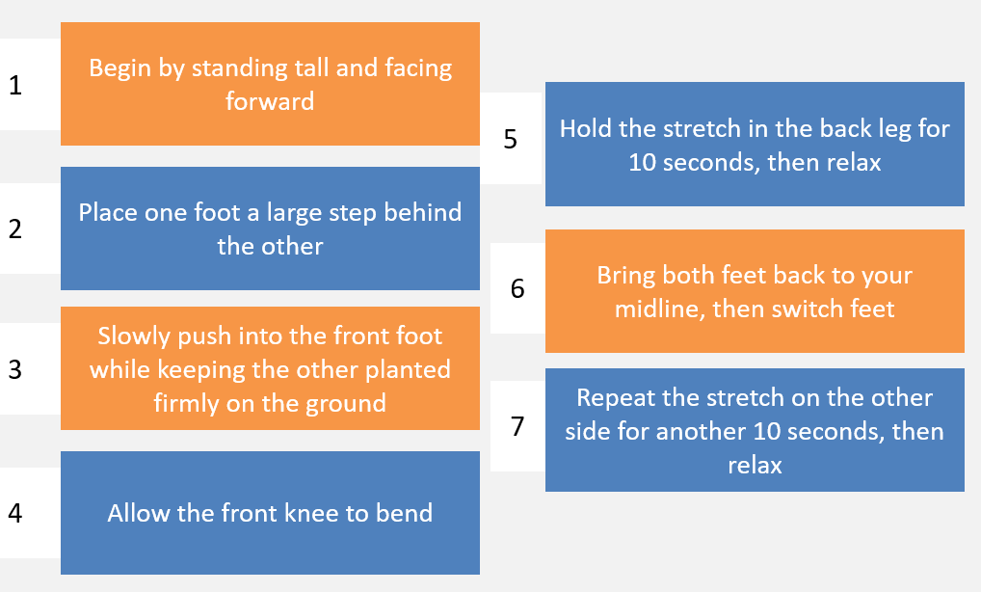
Calf Stretch

Slide 21
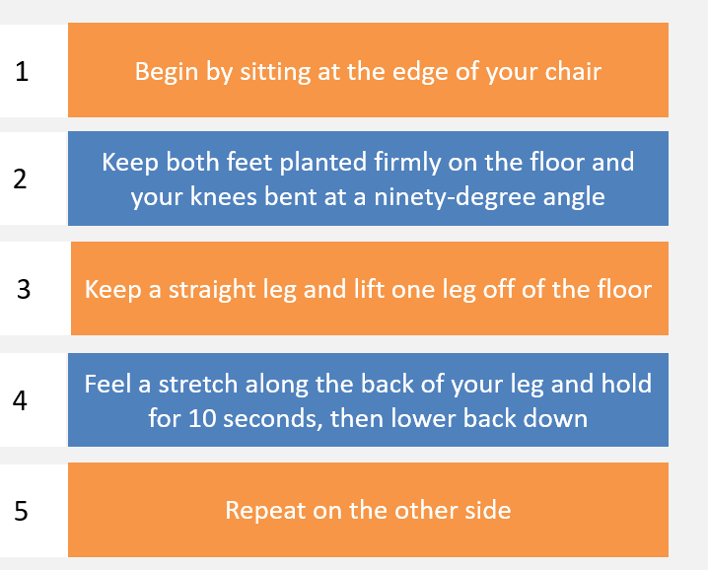
Seated Leg Lift/Hamstring Stretch

Slide 22
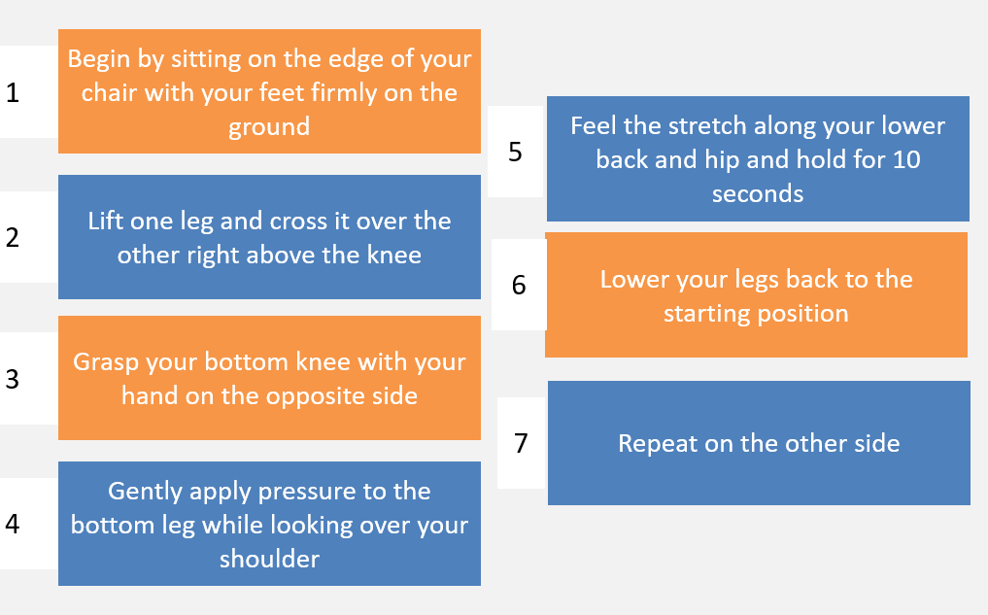
Seated Hip Stretch

